Slide 1
UCAST LARAVEL Training UI/UX Training
Final Project
Dalia Tariq Alhindi | Sajeda AlNazli
Asia Ahmed | Besan
Eng.Khalid

Slide 2
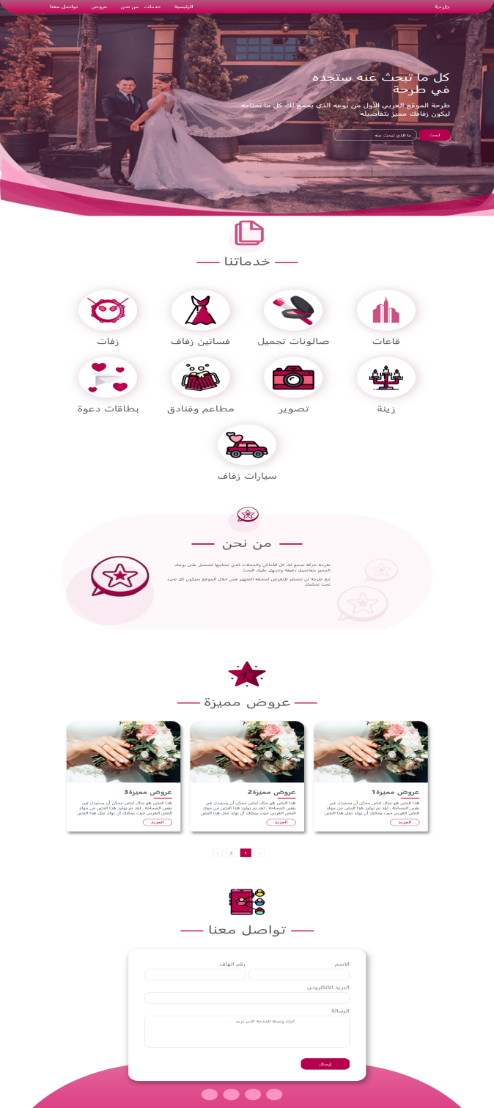
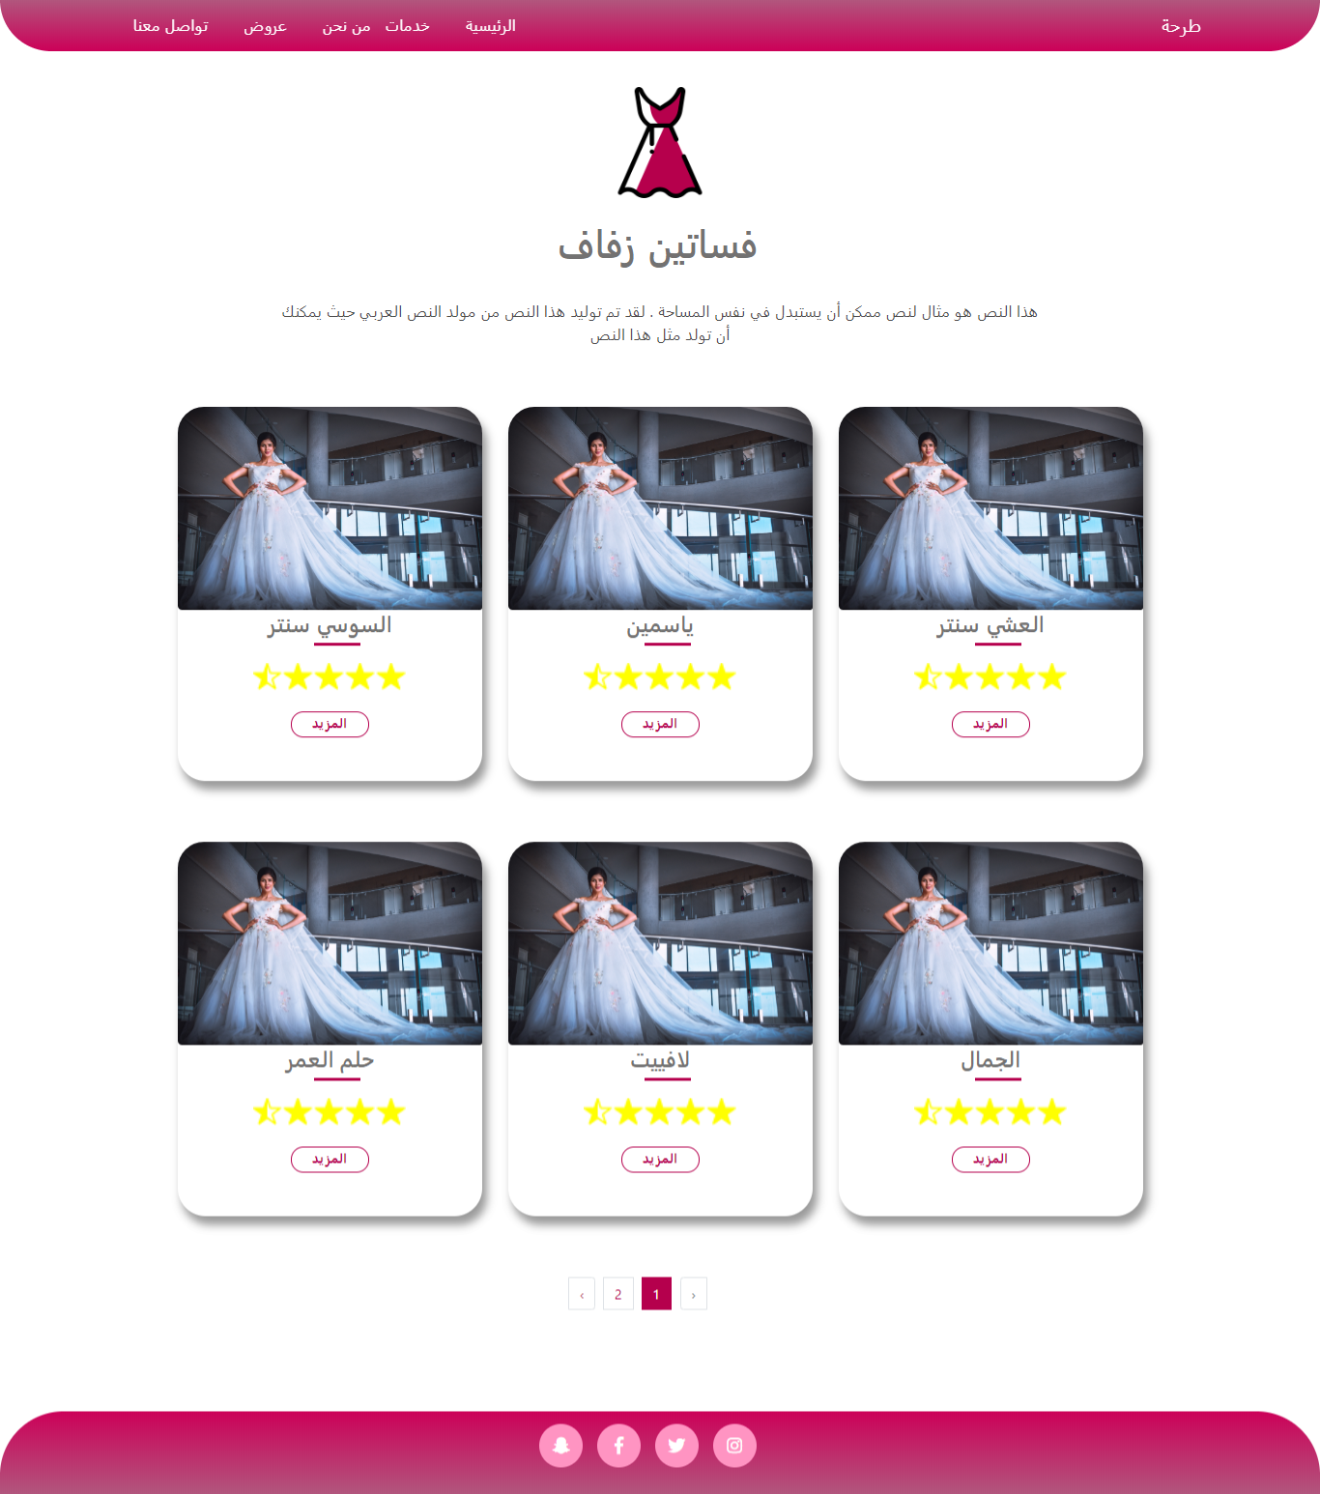
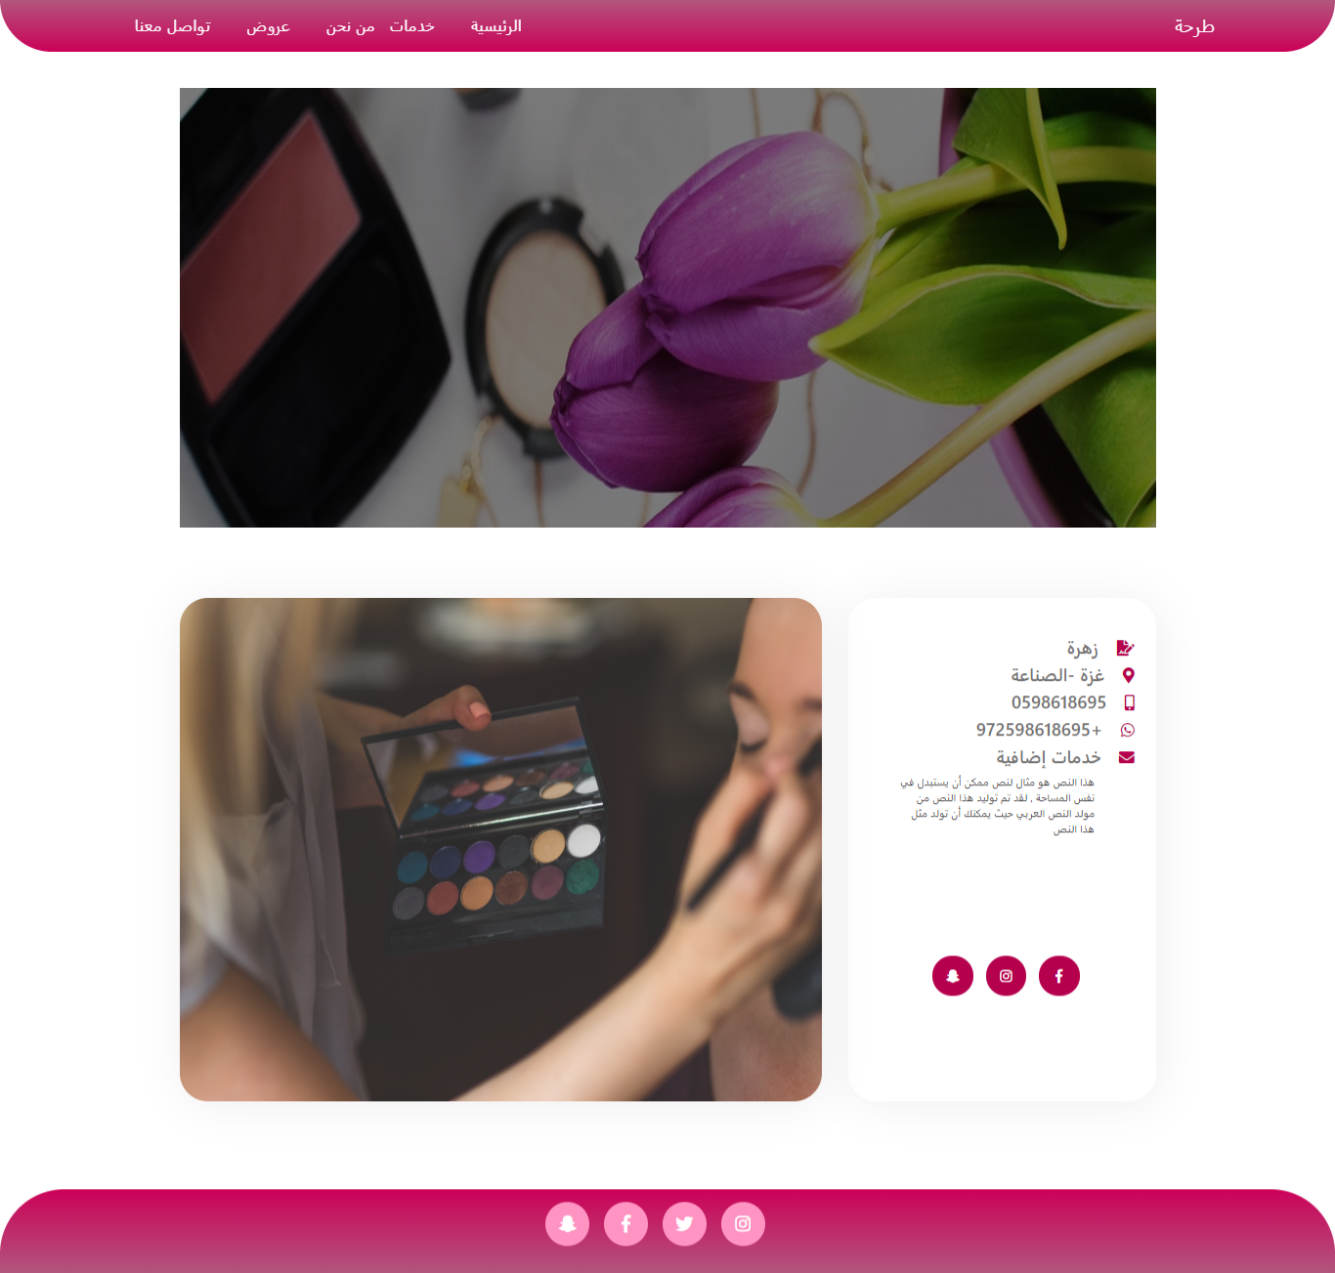
The main pages and the idea of project:

Slide 3
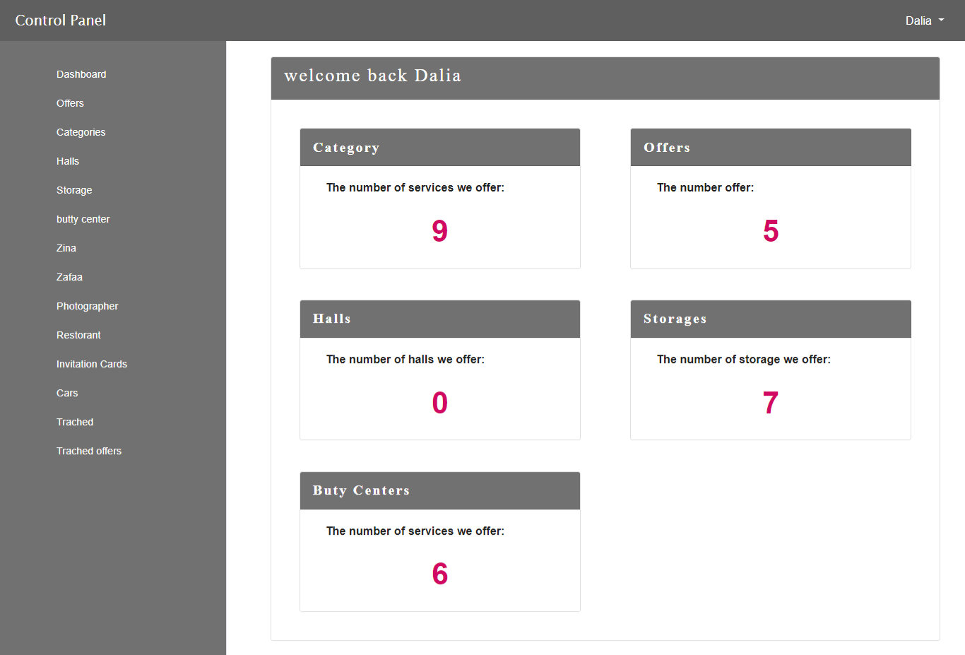
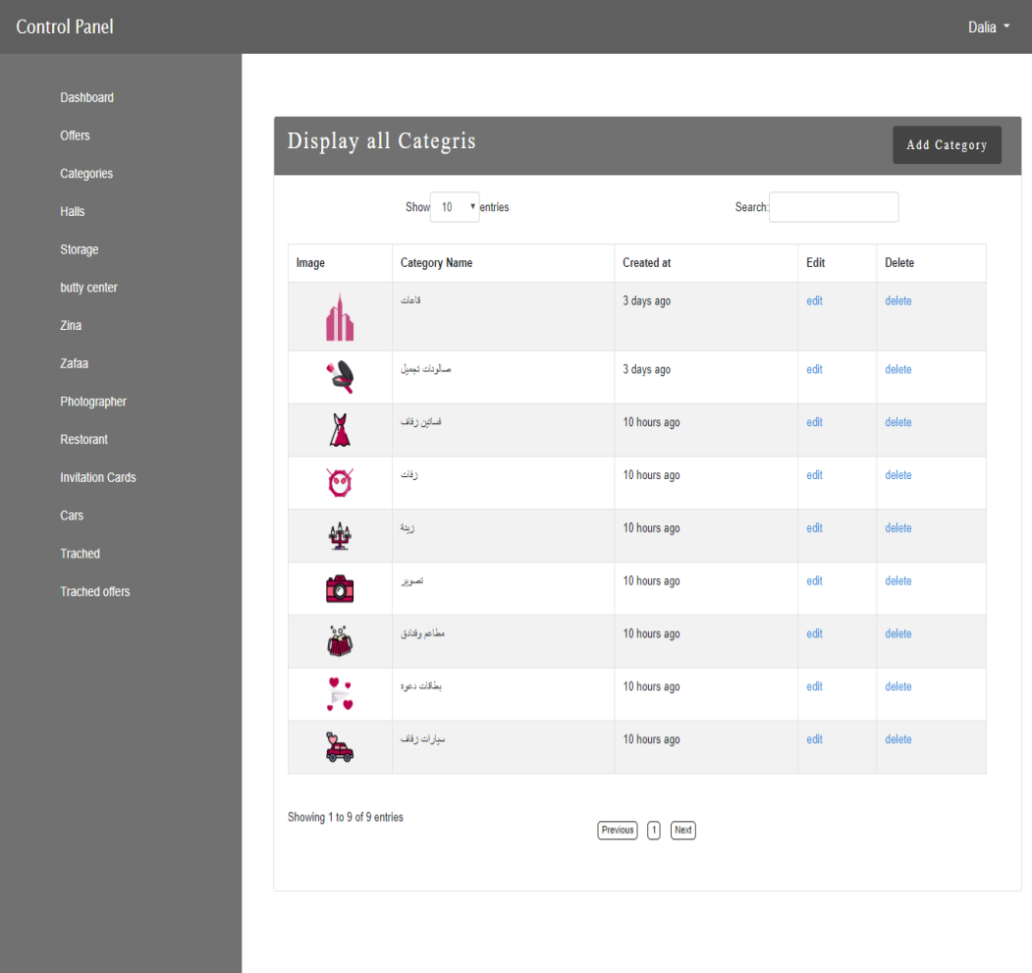
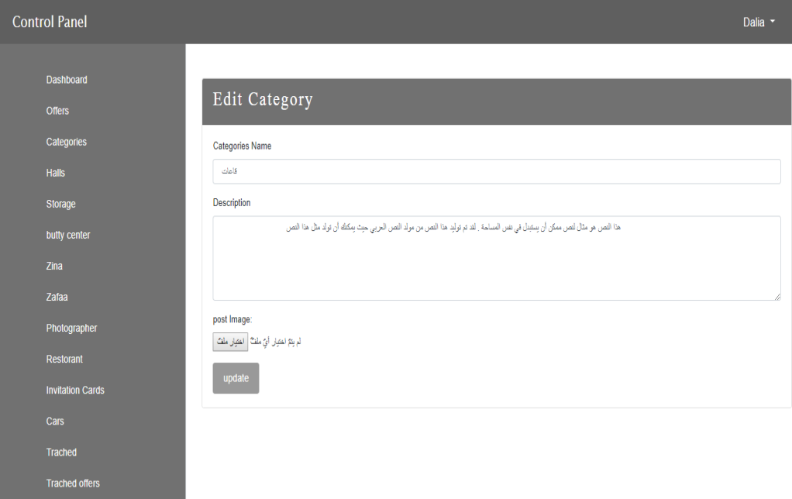
Control Panel:

Slide 4
Future Work:
Complete the key points in the project.
Make the site more interactive and create a user account through which they can determine their interest and ideas.
Activating the idea of wedding planning.
Automatic payment activation

Slide 5

Work experience

